Slide 1
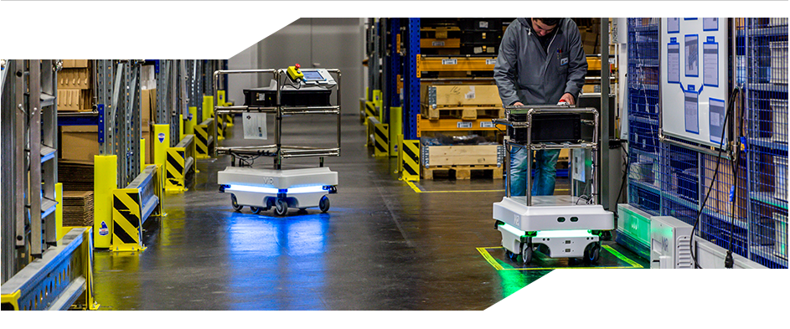
ROBOTIC HARDWARE SYSTEM
ROBOT TYPE: AUTOMATED GUIDED VEHICLE(AGV)
NAME: MOHAMAD LUQMAN IDLAN BIN MOHAMAD AZAHARI
MATRIC: 1723539

Slide 2
MAIN COMPONENTS
1. DESIGN
2. PROPULSION SYSTEM
3. NAVIGATION AND CONTROL SYSTEM
4. DATA TRANSMISSION AND COLLECTION
5. POWER MANAGEMENT

Slide 3
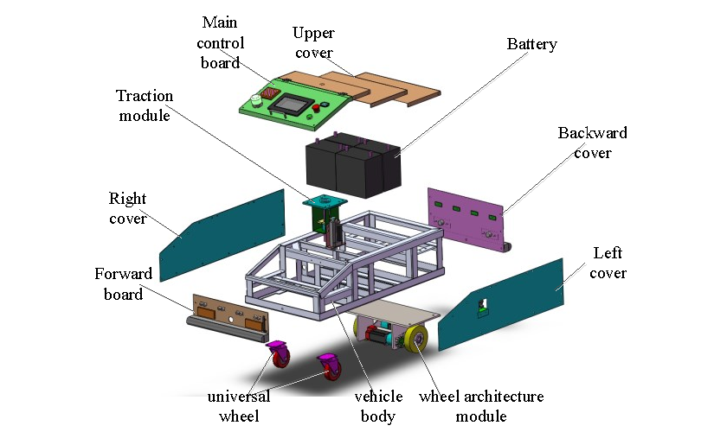
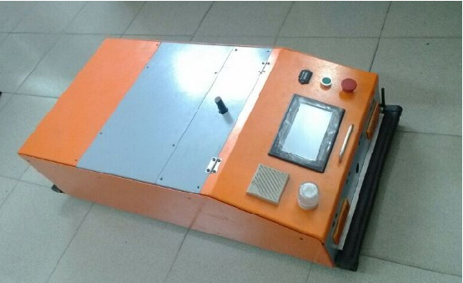
DESIGN
MECHANISM STRUCTURE AND OVERVIEW OF AGV

Slide 4
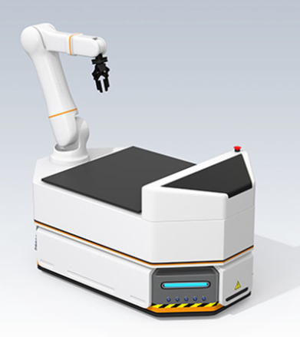
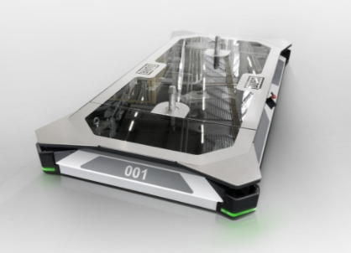
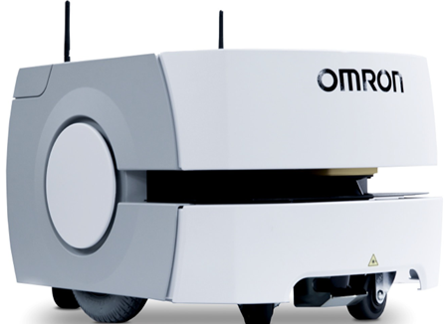
MORE DESIGNS

Slide 5
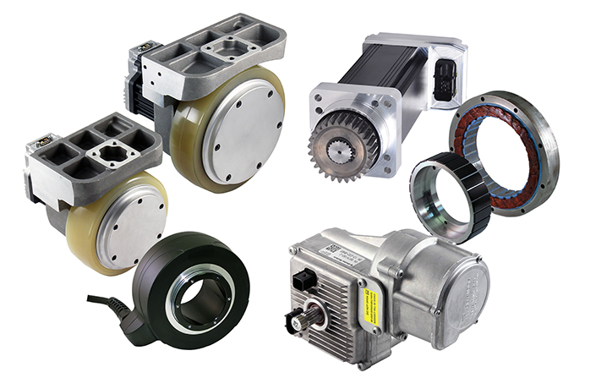
PROPULSION SYSTEM
GEARS
WHEELS
MOTOR

Slide 6
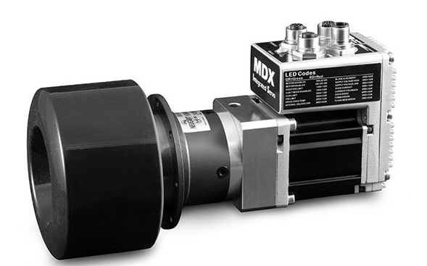
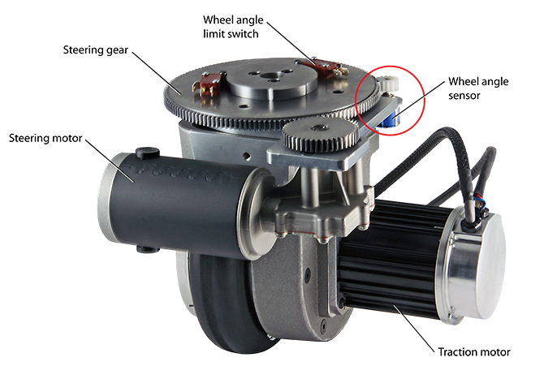
ACTUATOR
Consist of onboard motion control and brushless servomotor, planetary gearbox, and flange to mount a drive wheel.
Integrated traction-wheel

Slide 7
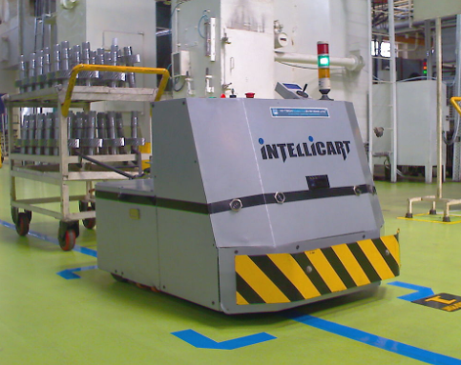
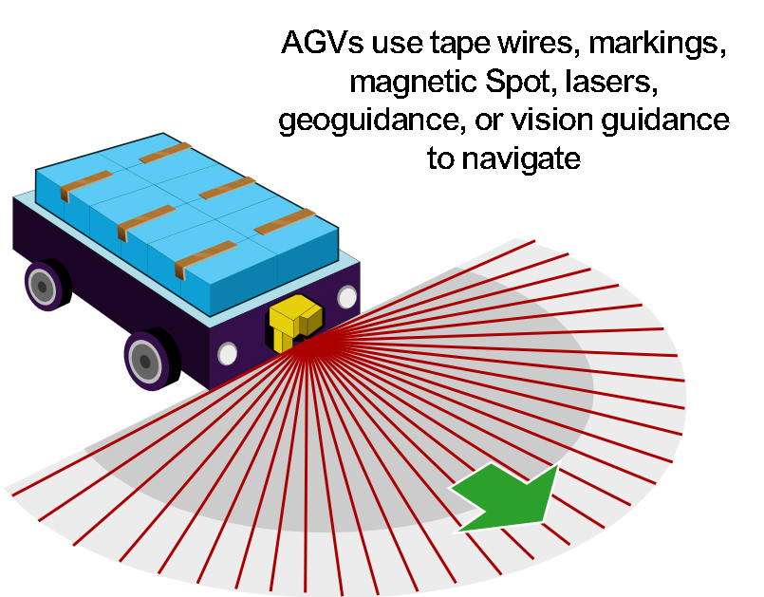
NAVIGATION AND CONTROL SYSTEM
AGV requires a navigation system that provides the ability for the vehicle to identify its position.
Most common ones are GPS based algorithm and a line following algorithm

Slide 8
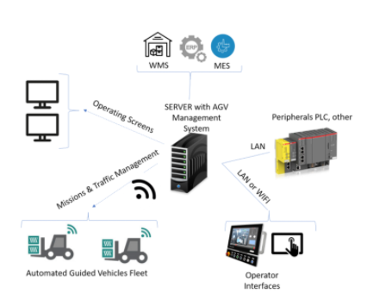
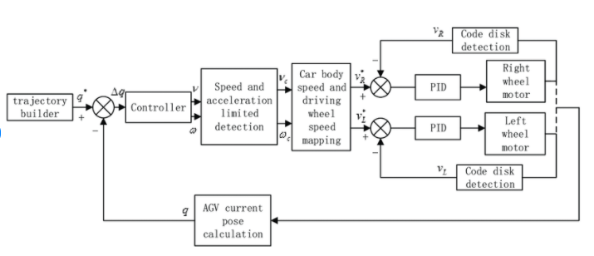
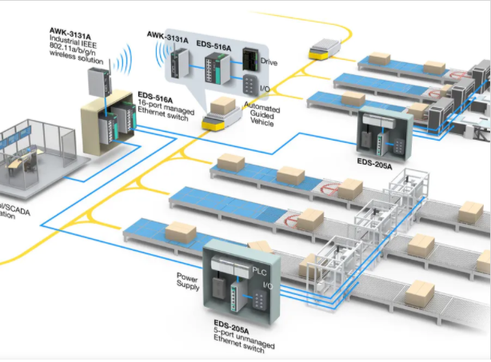
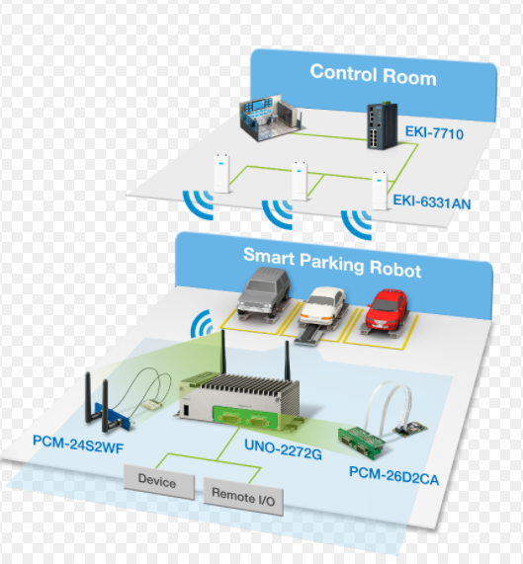
FURTHER...
AGV Management System
Block diagram of AGV control system
Computer Vision-Based Navigation System for Industrial AGVs
Intelligent parking/docking system

Slide 9





DATA TRANSMISSION AND COLLECTION
software for AGVs

Slide 10
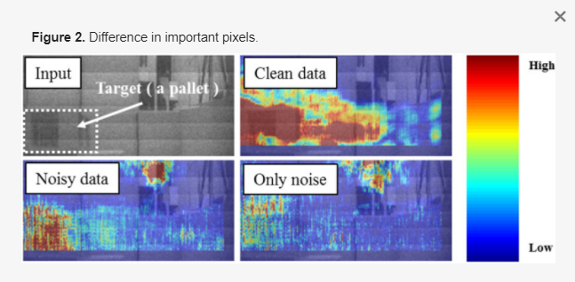
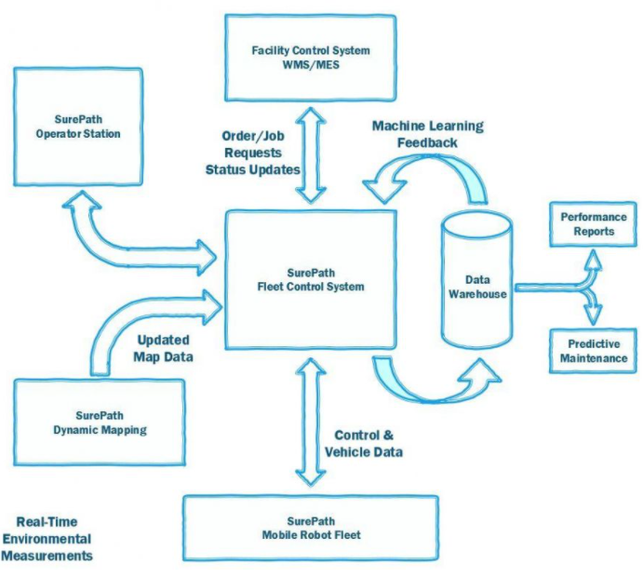
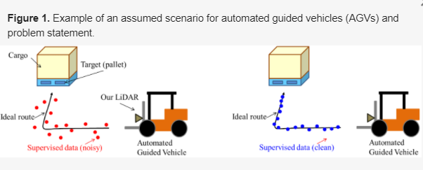
DATA PATHING
Pixels data for CNN-based localization.

Slide 11
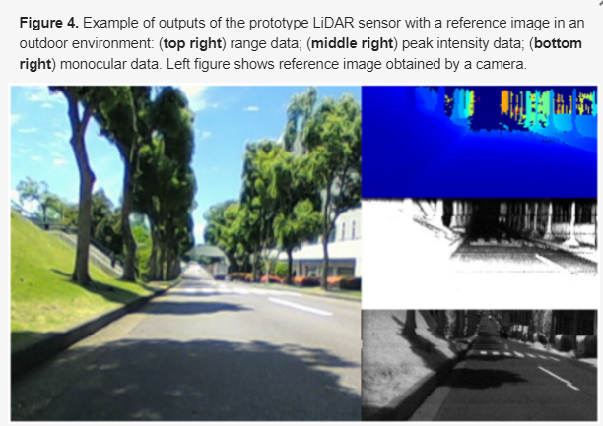
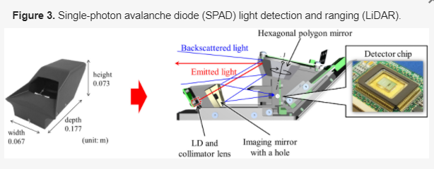
MORE DATA EXAMPLES

Slide 12
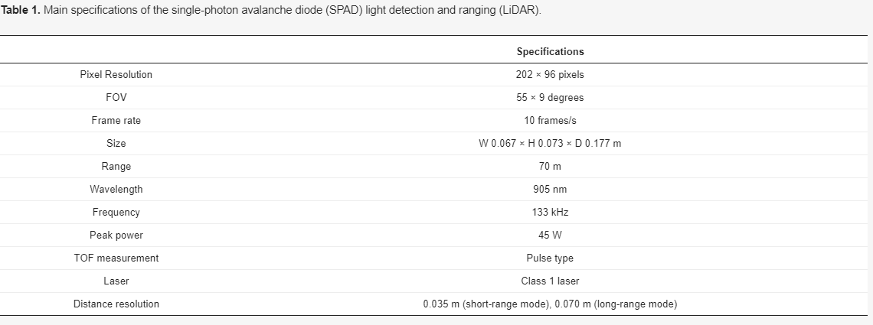
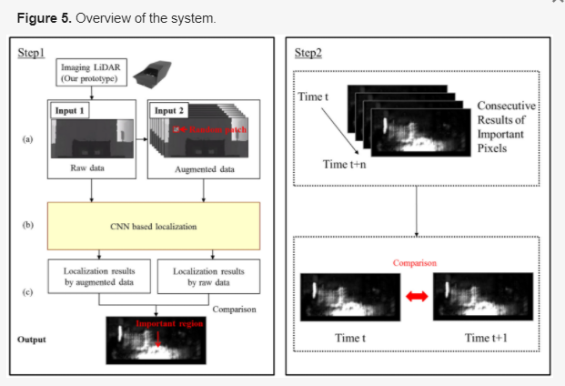
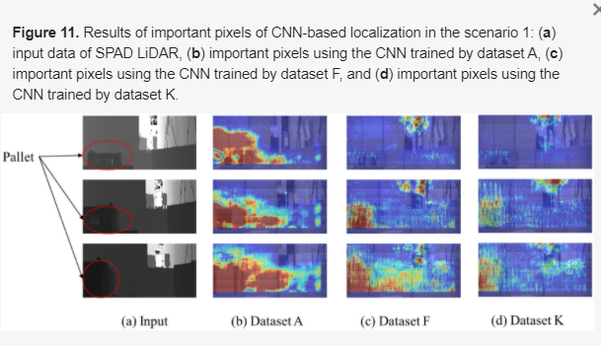
FURTHER EXAMPLES

Slide 13
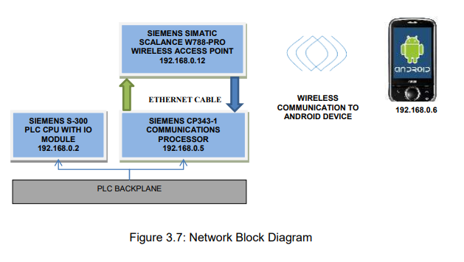
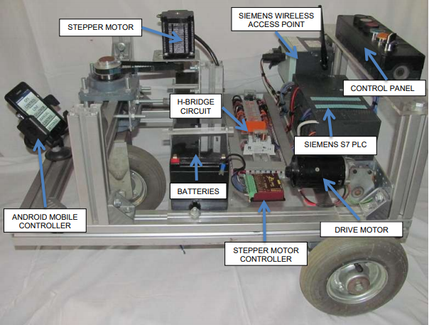
DATA TRANSMISSION
Made up of a normal LAN setup, combining WLAN for
integration to the Android phone. Also, it can be implemented for integration of SCADA system.

Slide 14
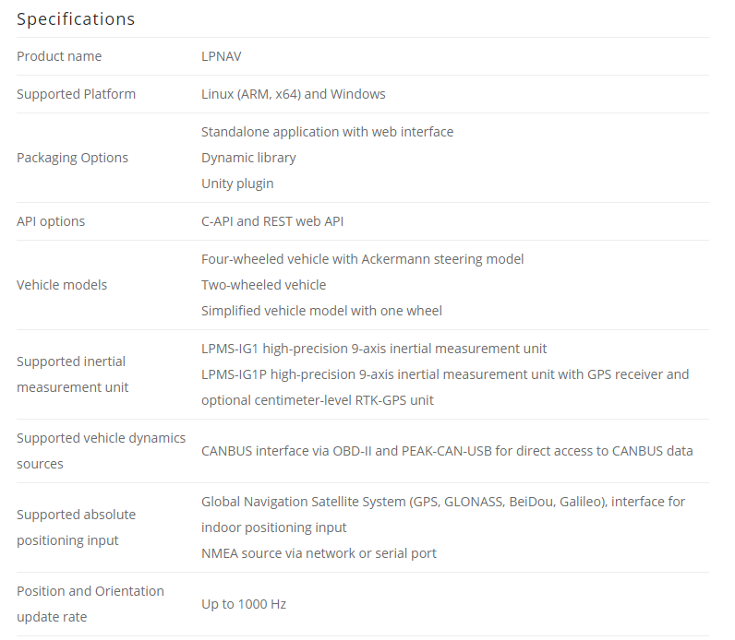
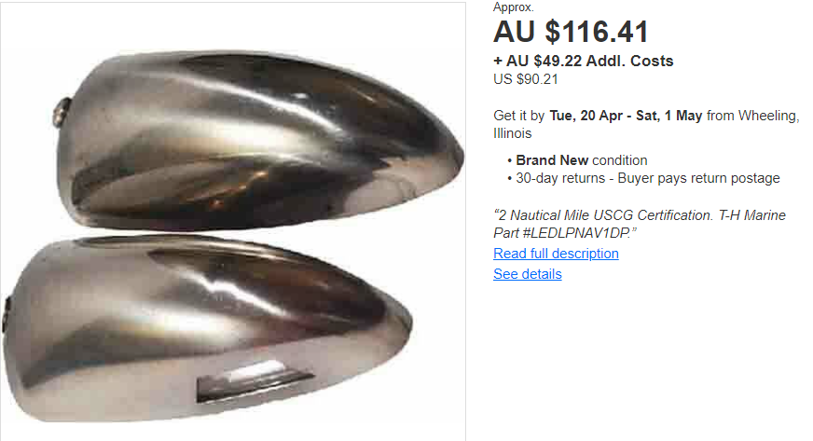
GPS TRANSMISSION
Automotive tracking to determine the location of an automotive vehicle in areas where GPS is not available or the signal is not reliable.

Slide 15
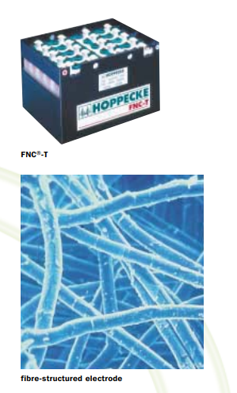
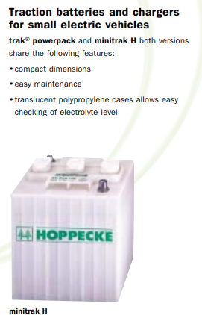
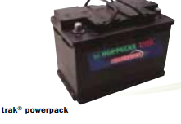
POWER MANAGEMENT
NiCd Batteries - robust, have a high cycle ability, a high performance and are easy to maintain.

Slide 16
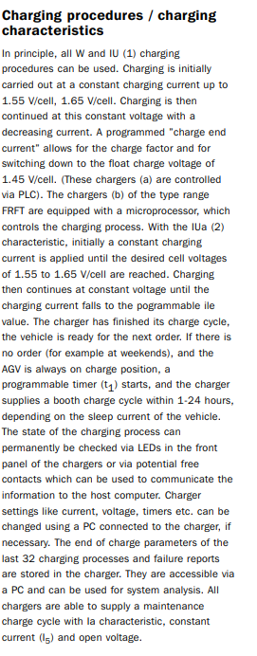
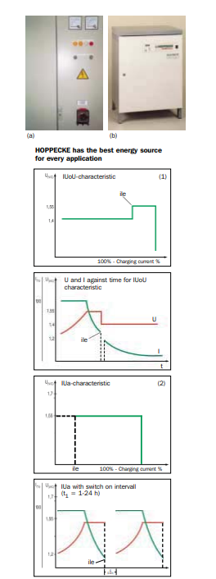
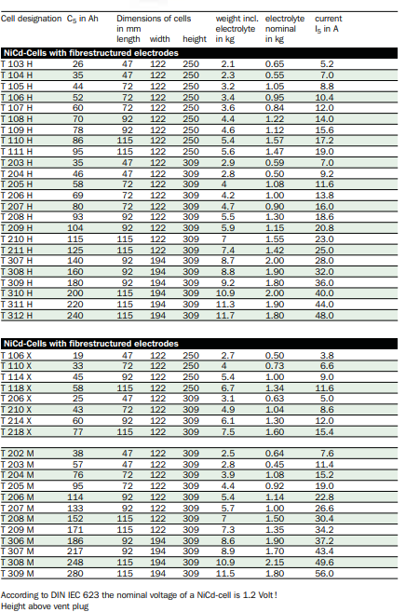
Charging system

